Slide 1
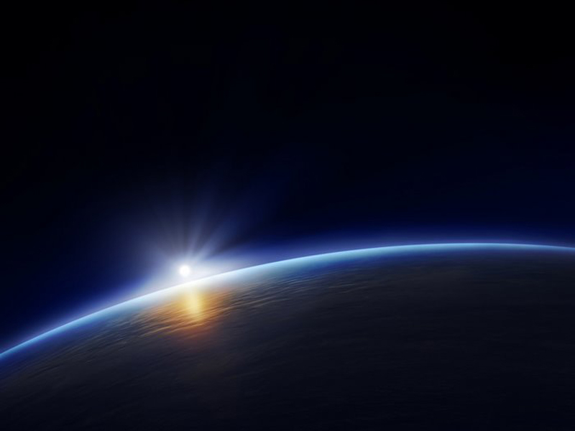
THE MISFITS PRESENTS
TEAM MEMBERS:
SHUBHAM SRIVASTAVA
UNNATI AGARWAL
SHASHANK SRIVASTAVA
UTTKARSH GAUR
SRISHTI SAXENA
INSTITUTION: GALGOTIAS COLLEGE OF ENGINEERING AND TECHNOLOGY

Slide 2




Slide 3
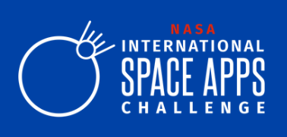
“TWINKLE TWINKLE LITTLE STARS”
A NASA SPACE APPS CHALLENGE
OUR CHALLENGE:
The stars above are constantly changing, but usually these changes are too slow or too faint for the eye to see. Your challenge is to develop a learning tool to teach people about stellar variability and help them understand how dynamic the night sky really is!

Slide 4
OUR SOLUTION?
TO MAKE THEM AWARE,
TO MAKE THEM CURIOUS.
SOLUTION WE ARE PROVIDING:
We worked and developed a website to help people understand that the stars in the night sky are always changing, but usually too slowly or by too little for the eye to see.
Ours is a curriculum solution which consist of materials that show examples of variable stars and explain how they vary and why. Building on this curriculum, A game in form of quizzes is designed at the end of website to show a player a ‘training set’ of examples and then show an actual star’s variations and ask the player to deduce what is causing the variation.
Although the content could be found anywhere on the internet, but in our website all data is stored at a single place and at a single time any user can access and get information and learn from it.
The language used in our website is super easy to understand and with help of lot of images and some videos every concept is super easy to learn and understand by users of any age group.
We tried to make best use of effective learning tools which provide an enjoyable and educational experience for players/students!

Slide 5
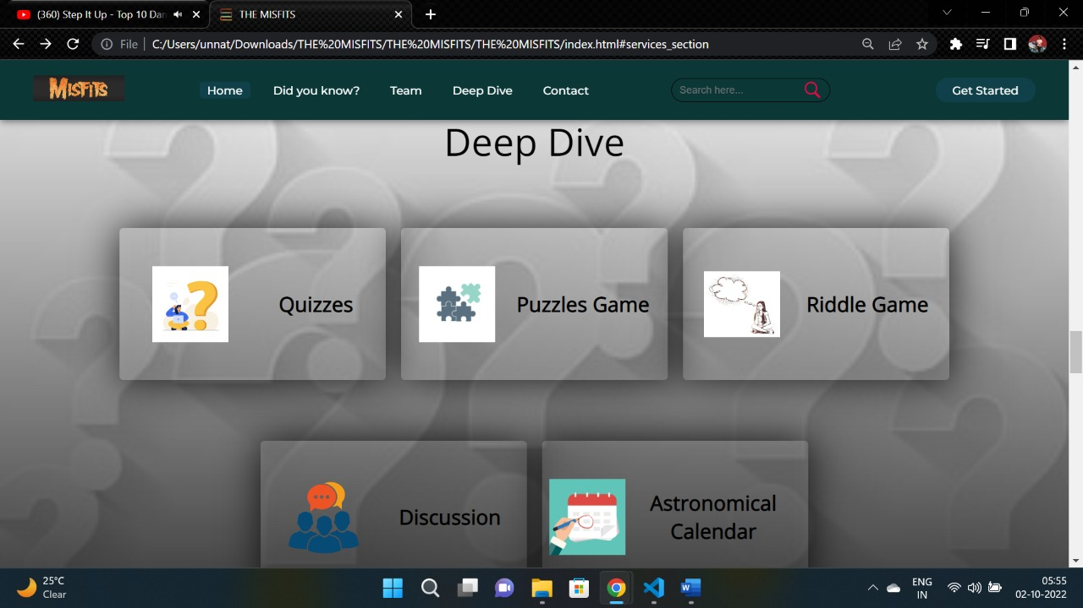
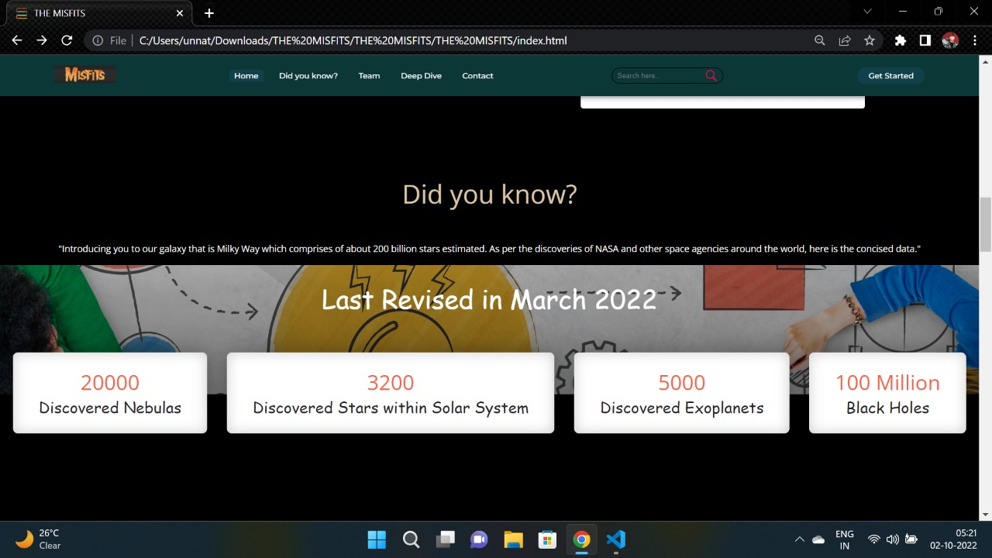
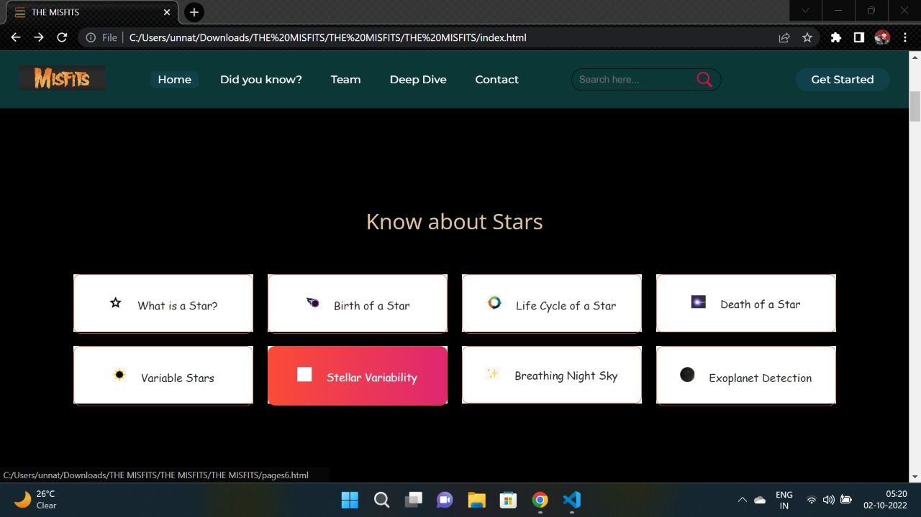
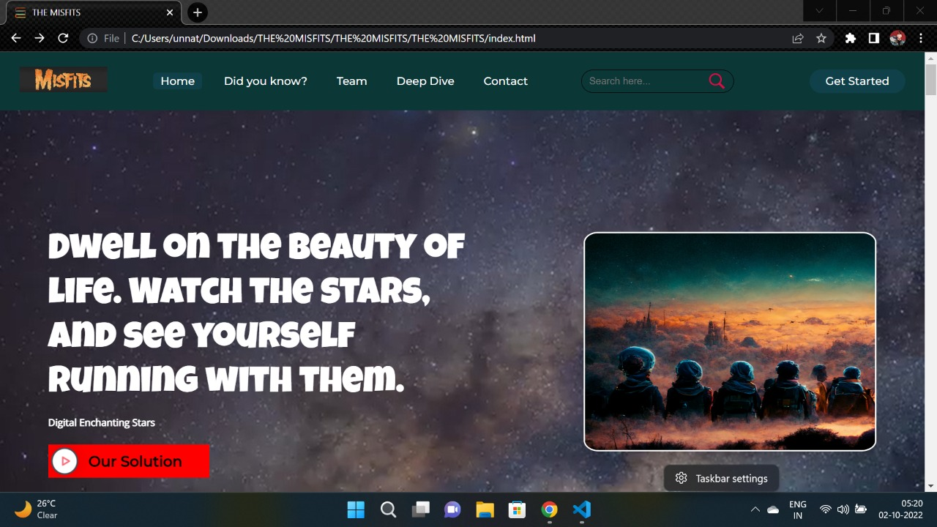
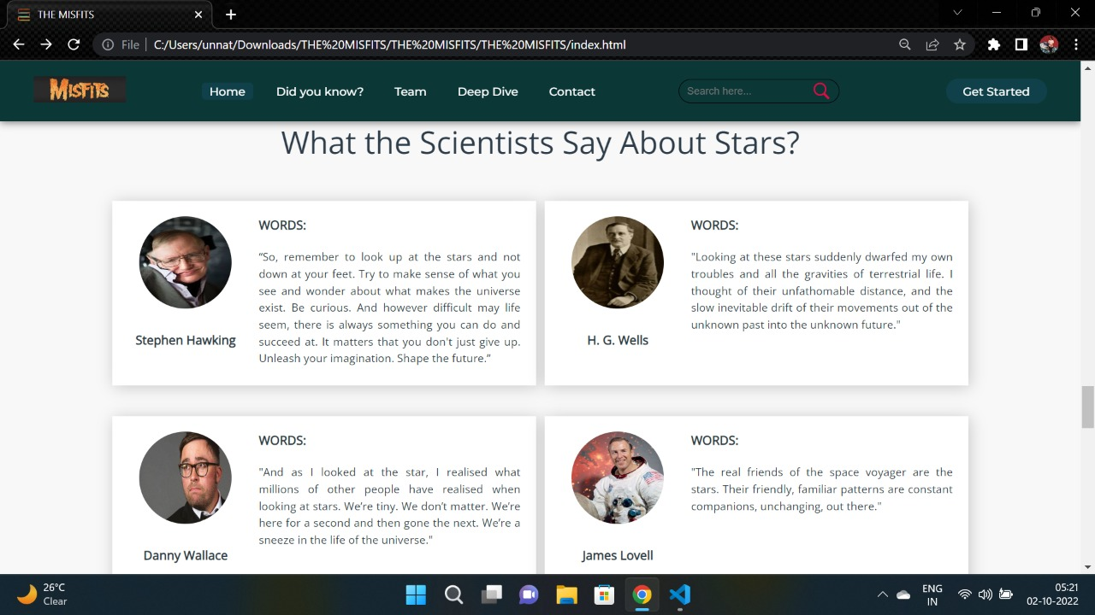
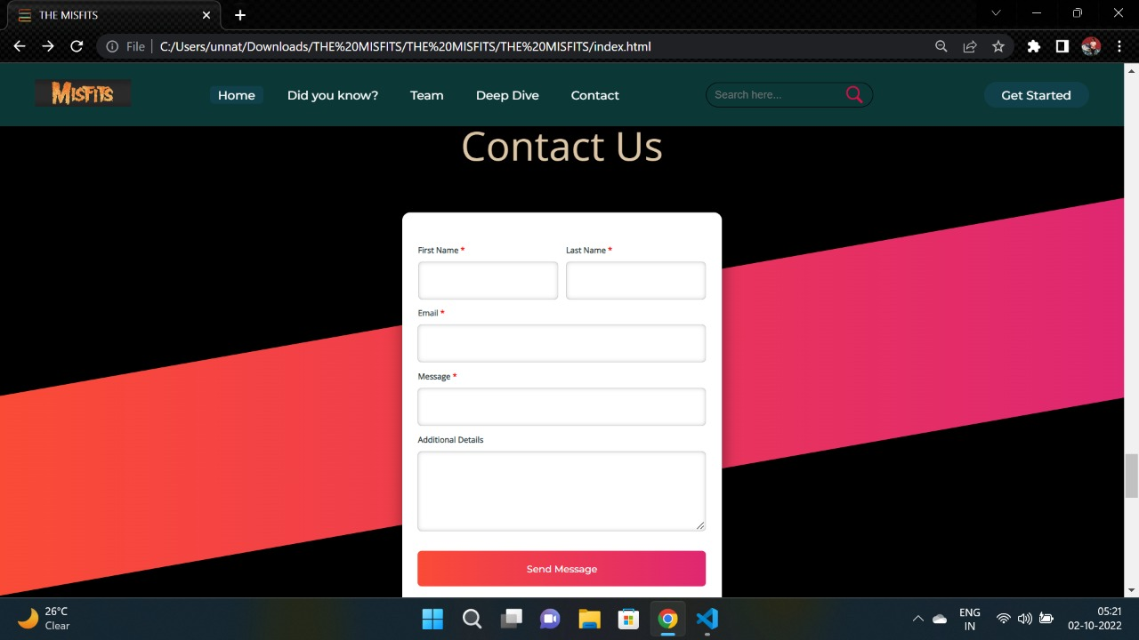
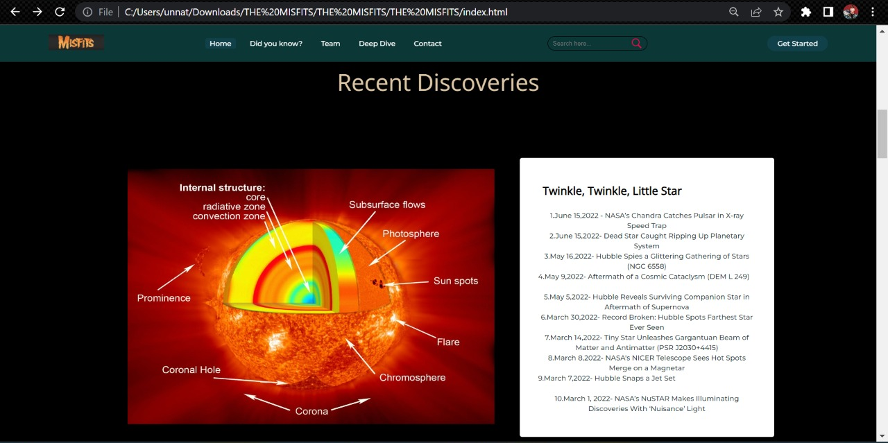
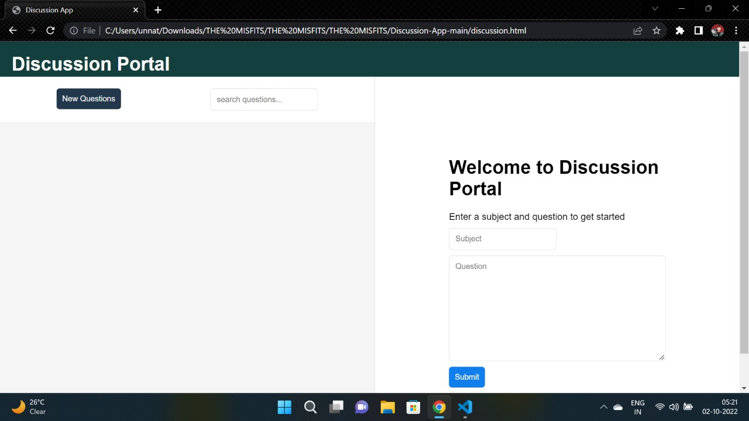
THE INTERFACE

Slide 6



TECHNOLOGIES USED
CSS
HTML
JAVASCRIPT

